Slide 1
ALPHA Gamma Delta
Western Kentucky University
Fall 2026
New Member Meeting
JESSICA Kayrouz Wissing
WESTERN Kentucky university
Class of 2000
BA History WITH Honors
Minor Women Studies
The Brandeis School of Law
At the University of Louisville
Jd 2003

Slide 2




Career Development

Slide 3
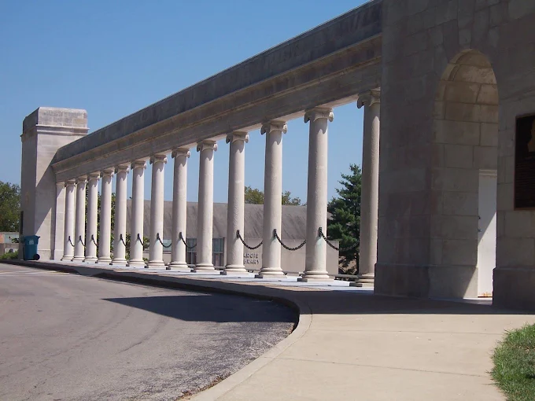
Career Development:
Focusing on Who You Are and What you are passionate about lays the foundation for your life after The Hill…….

Slide 4
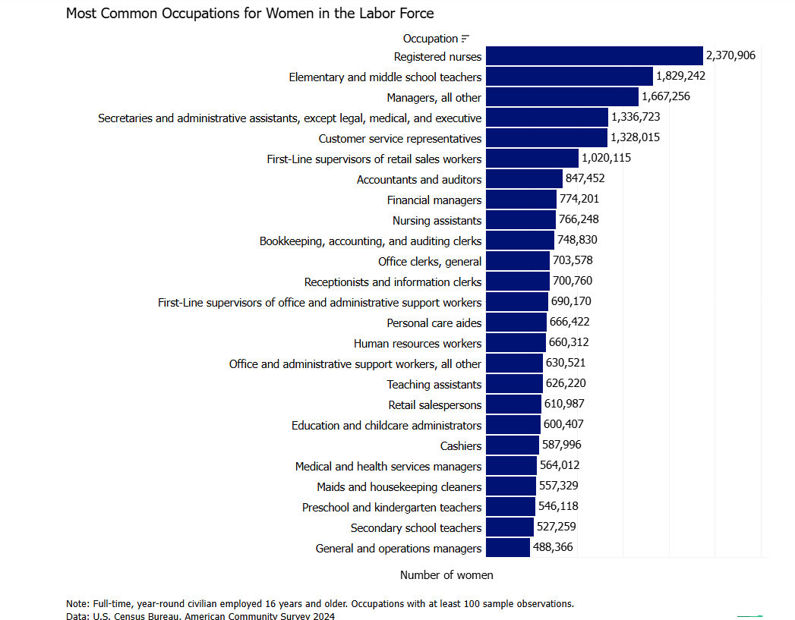
Walt Disney

Slide 5
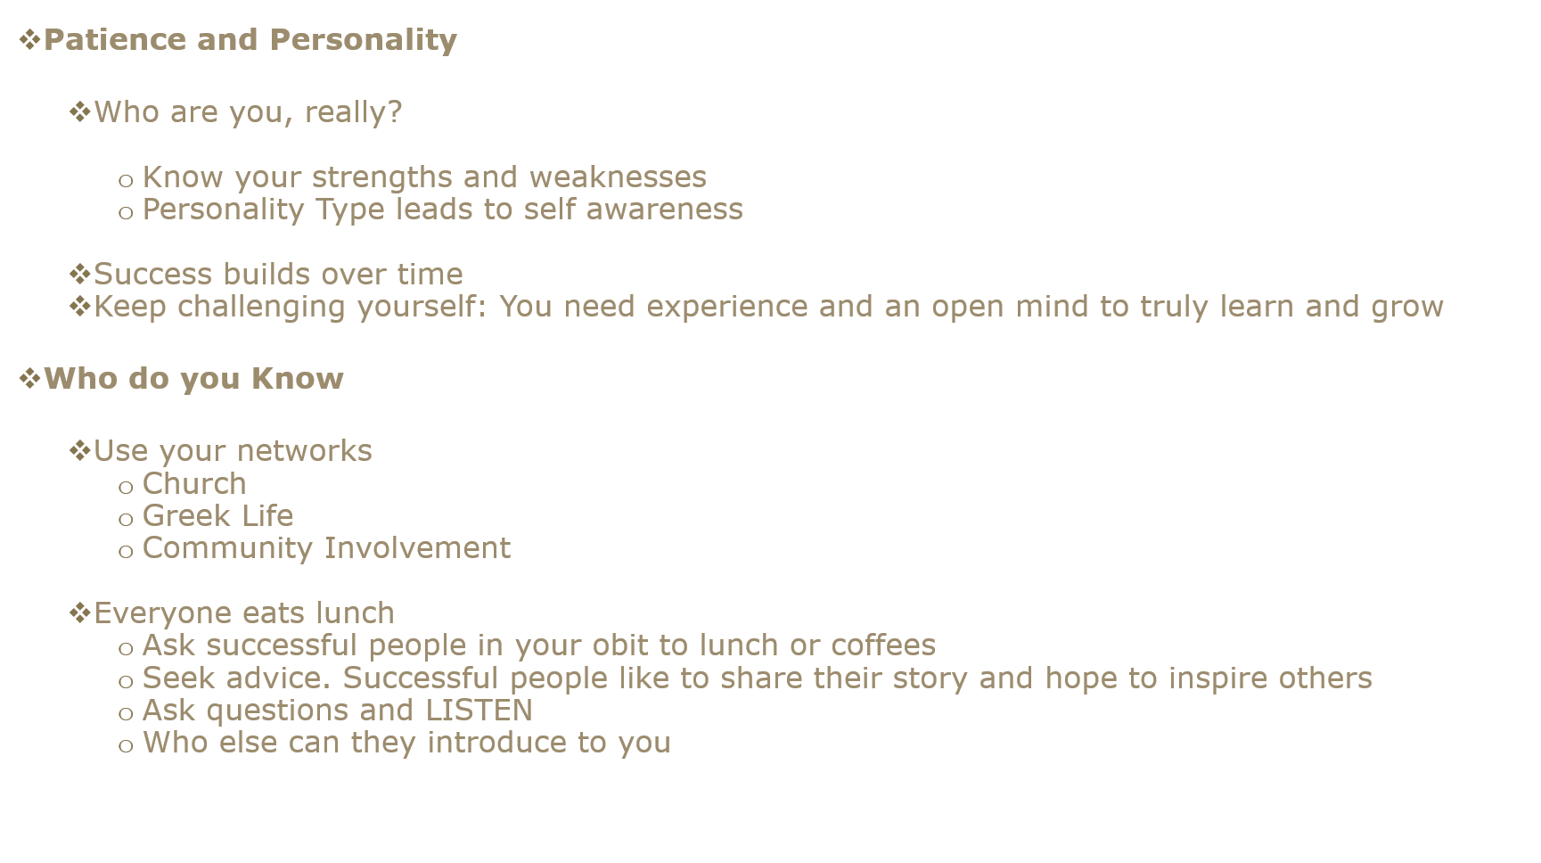

Slide 6
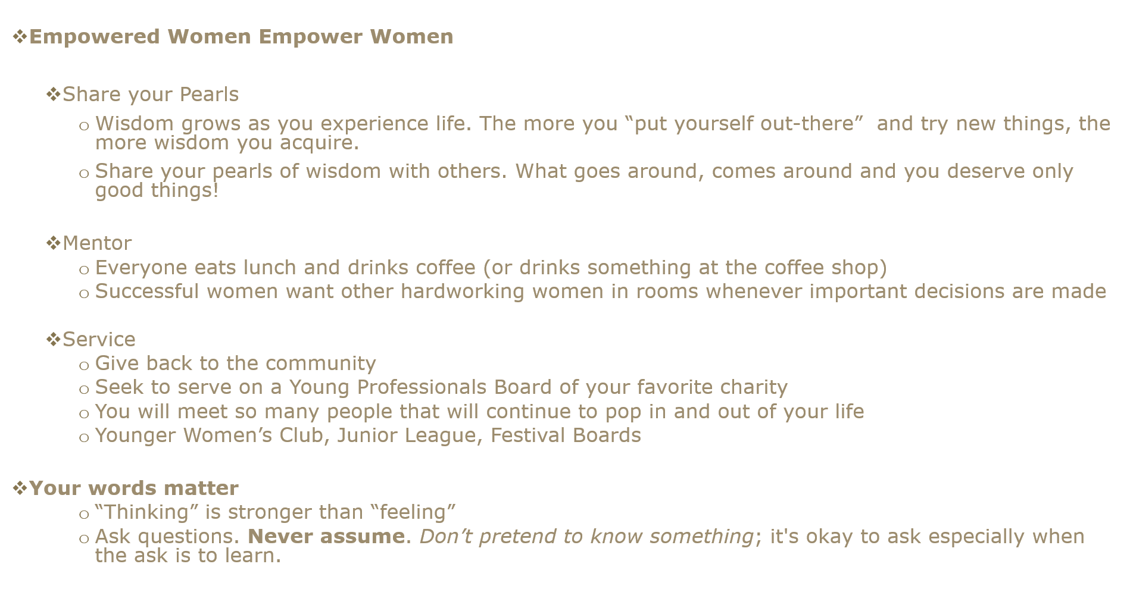

Slide 7
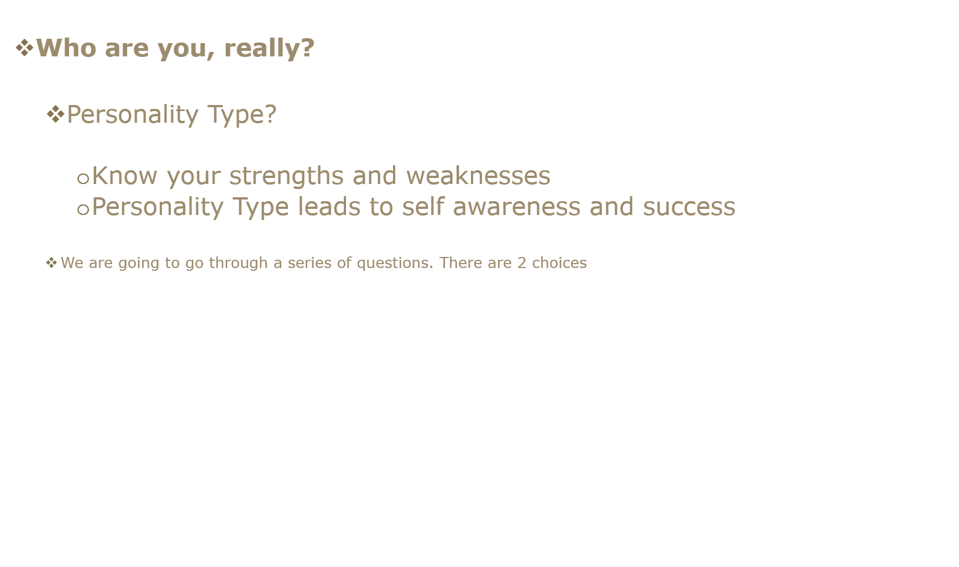

Slide 8
The
Insight
Game
What is your
personality type?
Thirty-six quick either/or choices. Four letters.
One surprisingly accurate picture of you.
A four-round personality experience
From The Insight System — created by Dr. Martine J. RoBards, Ph.D.

Slide 9
How to play
1
Four rounds, nine cards each
Every card has two choices — no wrong answers.
2
Click the card that sounds more like you
Go with your gut. First instinct is usually right.
3
After each round, write down your letter
The side you picked most. Four rounds = four letters.
4
Find your four-letter type and click it
Your result card tells you what it means — and where it shines.
This is the complete 36-card Insight Game.

Slide 10
ROUND 1
How You Recharge
E
Extravert
I
Introvert
You draw energy from people, activity, and talking things through.
You draw energy from quiet, depth, and time to think.
Start Round 1 →
Nine cards. Pick the one that sounds more like you — and keep your running tally.

Slide 11
ROUND 1 · HOW YOU RECHARGE
Which sounds more like you?
E
I
I have a wide circle of friends and acquaintances
I have a few close friends whose company I truly prefer
Card 1 of 9 · click your answer
Keep a quiet tally of your letters — you will need the winner at the end of the round.

Slide 12
ROUND 1 · HOW YOU RECHARGE
Which sounds more like you?
E
I
I prefer to talk things out — I learn by discussing
I prefer to think things through alone before speaking
Card 2 of 9 · click your answer
Keep a quiet tally of your letters — you will need the winner at the end of the round.

Slide 13
ROUND 1 · HOW YOU RECHARGE
Which sounds more like you?
E
I
I enjoy meeting new people and am energized by social events
I find most social events draining and prefer quiet evenings
Card 3 of 9 · click your answer
Keep a quiet tally of your letters — you will need the winner at the end of the round.

Slide 14
ROUND 1 · HOW YOU RECHARGE
Which sounds more like you?
E
I
At a party, I talk to many different people throughout the evening
At a party, I talk deeply with one or two people I connect with
Card 4 of 9 · click your answer
Keep a quiet tally of your letters — you will need the winner at the end of the round.

Slide 15
ROUND 1 · HOW YOU RECHARGE
Which sounds more like you?
E
I
I find it easy to approach strangers and start conversations
I find small talk with strangers awkward or draining
Card 5 of 9 · click your answer
Keep a quiet tally of your letters — you will need the winner at the end of the round.

Slide 16
ROUND 1 · HOW YOU RECHARGE
Which sounds more like you?
E
I
I think out loud — my best ideas come through conversation
I think privately — talking too soon disrupts my thinking process
Card 6 of 9 · click your answer
Keep a quiet tally of your letters — you will need the winner at the end of the round.

Slide 17
ROUND 1 · HOW YOU RECHARGE
Which sounds more like you?
E
I
Being around people gives me energy and lifts my mood
Being around people, even people I like, eventually tires me out
Card 7 of 9 · click your answer
Keep a quiet tally of your letters — you will need the winner at the end of the round.

Slide 18
ROUND 1 · HOW YOU RECHARGE
Which sounds more like you?
E
I
I tend to speak first and think it through as I talk
I think carefully before I speak and choose my words deliberately
Card 8 of 9 · click your answer
Keep a quiet tally of your letters — you will need the winner at the end of the round.

Slide 19
ROUND 1 · HOW YOU RECHARGE
Which sounds more like you?
E
I
I find silence uncomfortable and usually fill it with conversation
I find silence comfortable and even restorative
Card 9 of 9 · click your answer
Keep a quiet tally of your letters — you will need the winner at the end of the round.

Slide 20
Round 1 tally
Which letter did you choose more? Write it down.
E
Extravert
I
Introvert
You draw energy from people, activity, and talking things through.
You draw energy from quiet, depth, and time to think.
Next round →
Letter 1 of 4 · ✏ jot it down

Slide 21
ROUND 2
How You Take In Information
S
Sensor
N
Intuitive
You trust facts, details, and hands-on experience.
You trust patterns, possibilities, and the big picture.
Start Round 2 →
Nine cards. Pick the one that sounds more like you — and keep your running tally.

Slide 22
ROUND 2 · HOW YOU TAKE IN INFORMATION
Which sounds more like you?
S
N
I prefer concrete facts and practical information I can use now
I prefer ideas, patterns, and possibilities — what could be
Card 1 of 9 · click your answer
Keep a quiet tally of your letters — you will need the winner at the end of the round.

Slide 23
ROUND 2 · HOW YOU TAKE IN INFORMATION
Which sounds more like you?
S
N
When in doubt, I do what I've done before — tried and true is best
When in doubt, I try a new approach — inventing something works better
Card 2 of 9 · click your answer
Keep a quiet tally of your letters — you will need the winner at the end of the round.

Slide 24
ROUND 2 · HOW YOU TAKE IN INFORMATION
Which sounds more like you?
S
N
I read instructions carefully before starting and follow them
I rarely read instructions — I figure things out as I go
Card 3 of 9 · click your answer
Keep a quiet tally of your letters — you will need the winner at the end of the round.

Slide 25
ROUND 2 · HOW YOU TAKE IN INFORMATION
Which sounds more like you?
S
N
I trust established methods and proven procedures
I trust my intuition and look for creative angles first
Card 4 of 9 · click your answer
Keep a quiet tally of your letters — you will need the winner at the end of the round.

Slide 26
ROUND 2 · HOW YOU TAKE IN INFORMATION
Which sounds more like you?
S
N
I prefer specific, step-by-step information I can act on
I prefer big-picture overviews and concepts more than detailed steps
Card 5 of 9 · click your answer
Keep a quiet tally of your letters — you will need the winner at the end of the round.

Slide 27
ROUND 2 · HOW YOU TAKE IN INFORMATION
Which sounds more like you?
S
N
I value common sense and practical experience above all
I value imagination and theoretical insight above all
Card 6 of 9 · click your answer
Keep a quiet tally of your letters — you will need the winner at the end of the round.

Slide 28
ROUND 2 · HOW YOU TAKE IN INFORMATION
Which sounds more like you?
S
N
My memory is good for specific facts, dates, and concrete details
My memory is better for impressions, meanings, and overall patterns
Card 7 of 9 · click your answer
Keep a quiet tally of your letters — you will need the winner at the end of the round.

Slide 29
ROUND 2 · HOW YOU TAKE IN INFORMATION
Which sounds more like you?
S
N
I live mostly in the present — I deal with what's in front of me
I live mostly in the future — I'm always thinking ahead and imagining
Card 8 of 9 · click your answer
Keep a quiet tally of your letters — you will need the winner at the end of the round.

Slide 30
ROUND 2 · HOW YOU TAKE IN INFORMATION
Which sounds more like you?
S
N
I find detailed, hands-on work satisfying and grounding
I find theoretical, conceptual work more engaging than detailed tasks
Card 9 of 9 · click your answer
Keep a quiet tally of your letters — you will need the winner at the end of the round.

Slide 31
Round 2 tally
Which letter did you choose more? Write it down.
S
Sensor
N
Intuitive
You trust facts, details, and hands-on experience.
You trust patterns, possibilities, and the big picture.
Next round →
Letter 2 of 4 · ✏ jot it down

Slide 32
ROUND 3
How You Make Decisions
T
Thinker
F
Feeler
You decide with logic, fairness, and objective analysis.
You decide with values, empathy, and impact on people.
Start Round 3 →
Nine cards. Pick the one that sounds more like you — and keep your running tally.

Slide 33
ROUND 3 · HOW YOU MAKE DECISIONS
Which sounds more like you?
T
F
I make decisions based on logic, analysis, and objective criteria
I make decisions based on personal values and how people will be affected
Card 1 of 9 · click your answer
Keep a quiet tally of your letters — you will need the winner at the end of the round.

Slide 34
ROUND 3 · HOW YOU MAKE DECISIONS
Which sounds more like you?
T
F
I think it's more important to be honest than to be tactful
I think it's more important to be tactful than bluntly honest
Card 2 of 9 · click your answer
Keep a quiet tally of your letters — you will need the winner at the end of the round.

Slide 35
ROUND 3 · HOW YOU MAKE DECISIONS
Which sounds more like you?
T
F
I tend to be firm-minded and objective, even in emotional situations
I tend to be warm-hearted and empathetic, even when logic suggests otherwise
Card 3 of 9 · click your answer
Keep a quiet tally of your letters — you will need the winner at the end of the round.

Slide 36
ROUND 3 · HOW YOU MAKE DECISIONS
Which sounds more like you?
T
F
I respect competence and skill above most other qualities
I respect warmth and genuine caring above most other qualities
Card 4 of 9 · click your answer
Keep a quiet tally of your letters — you will need the winner at the end of the round.

Slide 37
ROUND 3 · HOW YOU MAKE DECISIONS
Which sounds more like you?
T
F
I can deliver bad news directly when it needs to be said
I find it very difficult to deliver bad news — I soften it considerably
Card 5 of 9 · click your answer
Keep a quiet tally of your letters — you will need the winner at the end of the round.

Slide 38
ROUND 3 · HOW YOU MAKE DECISIONS
Which sounds more like you?
T
F
I'm usually skeptical of emotional appeals that lack logical support
I'm usually moved by emotional appeals, even when the logic is weak
Card 6 of 9 · click your answer
Keep a quiet tally of your letters — you will need the winner at the end of the round.

Slide 39
ROUND 3 · HOW YOU MAKE DECISIONS
Which sounds more like you?
T
F
I can stay cool and analytical in situations that upset others
I take things personally, even when they aren't directed at me
Card 7 of 9 · click your answer
Keep a quiet tally of your letters — you will need the winner at the end of the round.

Slide 40
ROUND 3 · HOW YOU MAKE DECISIONS
Which sounds more like you?
T
F
I prefer fair treatment over kind treatment, if I have to choose
I prefer kind treatment over strictly fair treatment, if I have to choose
Card 8 of 9 · click your answer
Keep a quiet tally of your letters — you will need the winner at the end of the round.

Slide 41
ROUND 3 · HOW YOU MAKE DECISIONS
Which sounds more like you?
T
F
I notice logical inconsistencies immediately and feel compelled to point them out
I notice when someone's feelings are hurt and feel compelled to address that first
Card 9 of 9 · click your answer
Keep a quiet tally of your letters — you will need the winner at the end of the round.

Slide 42
Round 3 tally
Which letter did you choose more? Write it down.
T
Thinker
F
Feeler
You decide with logic, fairness, and objective analysis.
You decide with values, empathy, and impact on people.
Next round →
Letter 3 of 4 · ✏ jot it down

Slide 43
ROUND 4
How You Live Your Life
J
Judger
P
Perceiver
You like things planned, decided, and settled.
You like options open, flexible, and spontaneous.
Start Round 4 →
Nine cards. Pick the one that sounds more like you — and keep your running tally.

Slide 44
ROUND 4 · HOW YOU LIVE YOUR LIFE
Which sounds more like you?
J
P
I like to have things decided, settled, and planned in advance
I like to keep things open and flexible — I prefer to adapt as I go
Card 1 of 9 · click your answer
Keep a quiet tally of your letters — you will need the winner at the end of the round.

Slide 45
ROUND 4 · HOW YOU LIVE YOUR LIFE
Which sounds more like you?
J
P
I make lists and check things off — organization keeps me sane
I lose lists or forget them — I deal with things as they come up
Card 2 of 9 · click your answer
Keep a quiet tally of your letters — you will need the winner at the end of the round.

Slide 46
ROUND 4 · HOW YOU LIVE YOUR LIFE
Which sounds more like you?
J
P
I feel satisfied and relieved when a decision is made and done
I feel a little confined when a decision is made — I prefer to keep options open
Card 3 of 9 · click your answer
Keep a quiet tally of your letters — you will need the winner at the end of the round.

Slide 47
ROUND 4 · HOW YOU LIVE YOUR LIFE
Which sounds more like you?
J
P
I prefer a predictable schedule and get unsettled by last-minute changes
I prefer spontaneous plans and actually enjoy last-minute changes
Card 4 of 9 · click your answer
Keep a quiet tally of your letters — you will need the winner at the end of the round.

Slide 48
ROUND 4 · HOW YOU LIVE YOUR LIFE
Which sounds more like you?
J
P
I work steadily toward deadlines and finish well ahead of time
I work in bursts and often need the pressure of a deadline to get moving
Card 5 of 9 · click your answer
Keep a quiet tally of your letters — you will need the winner at the end of the round.

Slide 49
ROUND 4 · HOW YOU LIVE YOUR LIFE
Which sounds more like you?
J
P
My living and work spaces are organized — everything has a place
My spaces are a creative chaos that only I can navigate
Card 6 of 9 · click your answer
Keep a quiet tally of your letters — you will need the winner at the end of the round.

Slide 50
ROUND 4 · HOW YOU LIVE YOUR LIFE
Which sounds more like you?
J
P
I set goals and work systematically toward them
I follow inspiration and deal with goals loosely
Card 7 of 9 · click your answer
Keep a quiet tally of your letters — you will need the winner at the end of the round.

Slide 51
ROUND 4 · HOW YOU LIVE YOUR LIFE
Which sounds more like you?
J
P
I like to plan a trip in detail before leaving
I like to head out and see what happens
Card 8 of 9 · click your answer
Keep a quiet tally of your letters — you will need the winner at the end of the round.

Slide 52
ROUND 4 · HOW YOU LIVE YOUR LIFE
Which sounds more like you?
J
P
I feel stressed by open-ended, unresolved situations
I feel stressed by over-planning and rigid schedules
Card 9 of 9 · click your answer
Keep a quiet tally of your letters — you will need the winner at the end of the round.

Slide 53
Round 4 tally
Which letter did you choose more? Write it down.
J
Judger
P
Perceiver
You like things planned, decided, and settled.
You like options open, flexible, and spontaneous.
Build your type →
Letter 4 of 4 · ✏ jot it down

Slide 54
Put your four letters together
E / I
S / N
T / F
J / P
Round 1
Round 2
Round 3
Round 4
In order, your letters spell your four-letter type — like E N F P.
Find your type →
On the next slide, click your type to see your result.

Slide 55
Click your type
EMPATHIST
ANALYST
LEGALIST
REALIST
ENFP
ENTP
ESTJ
ESTP
INFP
INTP
ISTJ
ISTP
ENFJ
ENTJ
ESFJ
ESFP
INFJ
INTJ
ISFJ
ISFP
Relationships and human potential are your central focus
Intellectual mastery and strategic thinking drive you
Responsibility, tradition, and duty anchor your world
Freedom, action, and living in the moment define you
The four color groups are the Insight System temperaments.

Slide 56
YOUR TYPE
ENFP
EMPATHIST
Relationships and human potential are your central focus
Energetic, creative, and deeply attuned to possibilities in people and ideas. Your enthusiasm is contagious.
Creative
Enthusiastic
Empathetic
Spontaneous
Visionary
Career edge:
Vision + people-energy: marketing, advocacy, teaching, entrepreneurship.
← All types
Wrap up →

Slide 57
YOUR TYPE
INFP
EMPATHIST
Relationships and human potential are your central focus
Gentle, idealistic, and guided by a deep inner compass of personal values. A quiet but fierce commitment to what matters most.
Idealistic
Empathetic
Creative
Reflective
Authentic
Career edge:
Purpose-driven paths: writing, counseling, nonprofit work, design.
← All types
Wrap up →

Slide 58
YOUR TYPE
ENFJ
EMPATHIST
Relationships and human potential are your central focus
A natural leader whose warmth and vision inspire others to become their best selves.
Charismatic
Empathetic
Visionary
Organized
Inspiring
Career edge:
Developing people: HR, education, communications, organizational leadership.
← All types
Wrap up →

Slide 59
YOUR TYPE
INFJ
EMPATHIST
Relationships and human potential are your central focus
Insightful, principled, and quietly passionate. You often know things before you can explain how.
Insightful
Principled
Creative
Determined
Empathetic
Career edge:
Insight-driven work: psychology, strategy, writing, mission-led leadership.
← All types
Wrap up →

Slide 60
YOUR TYPE
ENTP
ANALYST
Intellectual mastery and strategic thinking drive you
Inventive, quick-witted, and endlessly curious. You live to explore ideas and challenge assumptions.
Innovative
Quick-witted
Resourceful
Curious
Debater
Career edge:
Innovation + persuasion: law, consulting, startups, product strategy.
← All types
Wrap up →

Slide 61
YOUR TYPE
INTP
ANALYST
Intellectual mastery and strategic thinking drive you
Analytical, inventive, and deeply logical. You seek to understand the underlying principles behind everything.
Analytical
Independent
Inventive
Logical
Curious
Career edge:
Deep problem-solving: research, engineering, analysis, systems design.
← All types
Wrap up →

Slide 62
YOUR TYPE
ENTJ
ANALYST
Intellectual mastery and strategic thinking drive you
Decisive, strategic, and naturally commanding. You see the big picture and drive execution.
Strategic
Decisive
Confident
Efficient
Visionary
Career edge:
Command of complex goals: executive leadership, law, finance, operations.
← All types
Wrap up →

Slide 63
YOUR TYPE
INTJ
ANALYST
Intellectual mastery and strategic thinking drive you
Strategic, independent, and intensely focused. You see patterns others miss and create systems from complexity.
Strategic
Independent
Determined
Innovative
Analytical
Career edge:
Long-range strategy: science, architecture, planning, technical leadership.
← All types
Wrap up →

Slide 64
YOUR TYPE
ESTJ
LEGALIST
Responsibility, tradition, and duty anchor your world
Organized, dependable, and driven by a strong sense of duty. You bring order to chaos.
Organized
Dependable
Direct
Practical
Leadership
Career edge:
Running things well: management, administration, law, project leadership.
← All types
Wrap up →

Slide 65
YOUR TYPE
ISTJ
LEGALIST
Responsibility, tradition, and duty anchor your world
Thorough, reliable, and deeply committed to doing things right. The backbone of any organization.
Reliable
Thorough
Practical
Loyal
Organized
Career edge:
Precision + reliability: accounting, law, medicine, logistics, auditing.
← All types
Wrap up →

Slide 66
YOUR TYPE
ESFJ
LEGALIST
Responsibility, tradition, and duty anchor your world
Warm, conscientious, and deeply invested in the wellbeing of those around you.
Warm
Conscientious
Loyal
Harmonizing
Generous
Career edge:
Service with structure: nursing, teaching, events, community leadership.
← All types
Wrap up →

Slide 67
YOUR TYPE
ISFJ
LEGALIST
Responsibility, tradition, and duty anchor your world
Caring, meticulous, and quietly devoted to the people and causes you believe in.
Caring
Reliable
Observant
Supportive
Meticulous
Career edge:
Steady care: healthcare, education, administration, social work.
← All types
Wrap up →

Slide 68
YOUR TYPE
ESTP
REALIST
Freedom, action, and living in the moment define you
Bold, pragmatic, and fully alive in the present moment. You read situations instantly.
Bold
Pragmatic
Energetic
Perceptive
Adaptable
Career edge:
Action under pressure: sales, emergency services, athletics, entrepreneurship.
← All types
Wrap up →

Slide 69
YOUR TYPE
ISTP
REALIST
Freedom, action, and living in the moment define you
Resourceful, analytical, and masterfully skilled with tools and systems.
Resourceful
Analytical
Independent
Skilled
Calm
Career edge:
Hands-on mastery: engineering, trades, aviation, forensics, technology.
← All types
Wrap up →

Slide 70
YOUR TYPE
ESFP
REALIST
Freedom, action, and living in the moment define you
Vivacious, spontaneous, and deeply connected to the people and world around you.
Energetic
Warm
Spontaneous
People-loving
Generous
Career edge:
People-facing energy: hospitality, performance, PR, healthcare, sales.
← All types
Wrap up →

Slide 71
YOUR TYPE
ISFP
REALIST
Freedom, action, and living in the moment define you
Gentle, sensitive, and quietly passionate — an action-oriented idealist living by deeply personal values.
Quietly passionate
Artistic
Value-driven
Freedom-loving
Gentle
Career edge:
Craft + quiet impact: design, healthcare, culinary arts, veterinary work.
← All types
Wrap up →

Slide 72
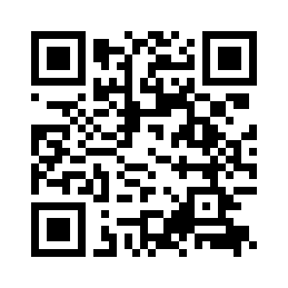
One last step — get your report.
Scan the code, enter your four letters and your email, and your personalized Insight report — written for your exact type — will land in your inbox.
insight-game.com/agd
Takes about 20 seconds · Free
Scan to get your report
The Insight System · Dr. Martine J. RoBards, Ph.D.
This game is built on the life’s work of Dr. Martine J. RoBards — a clinician who spent thirty years studying why people think, love, and choose so differently. She believed that understanding your type is the beginning of understanding each other. Her son, Michael A. RoBards, LCSW, carries her work forward today.

